Slide 1

Lecture 1a- Introduction
CS 620 / DASC 600
Introduction to Data Science & Analytics
Dr. Sampath Jayarathna
Old Dominion University

Slide 2
Today
Who I am
CS 620 educational objectives (and why)
Overview of the course, and logistics

Slide 3
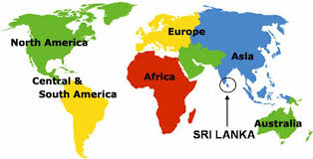
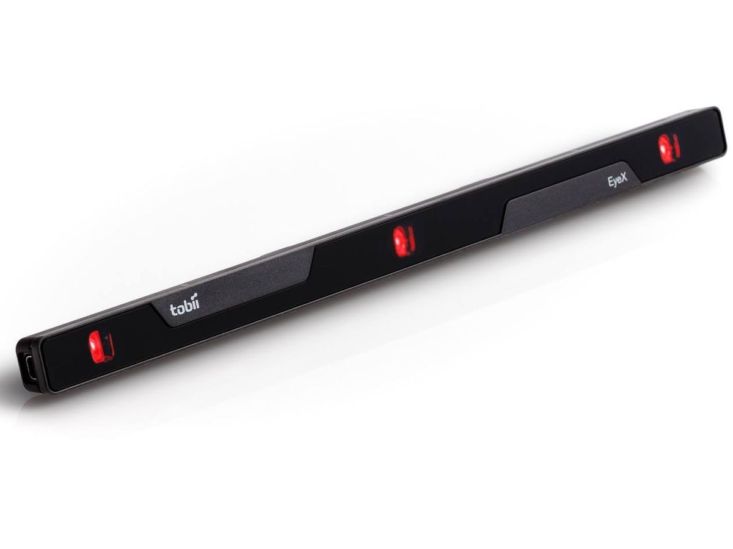
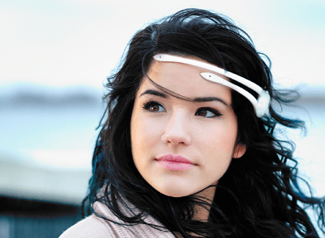
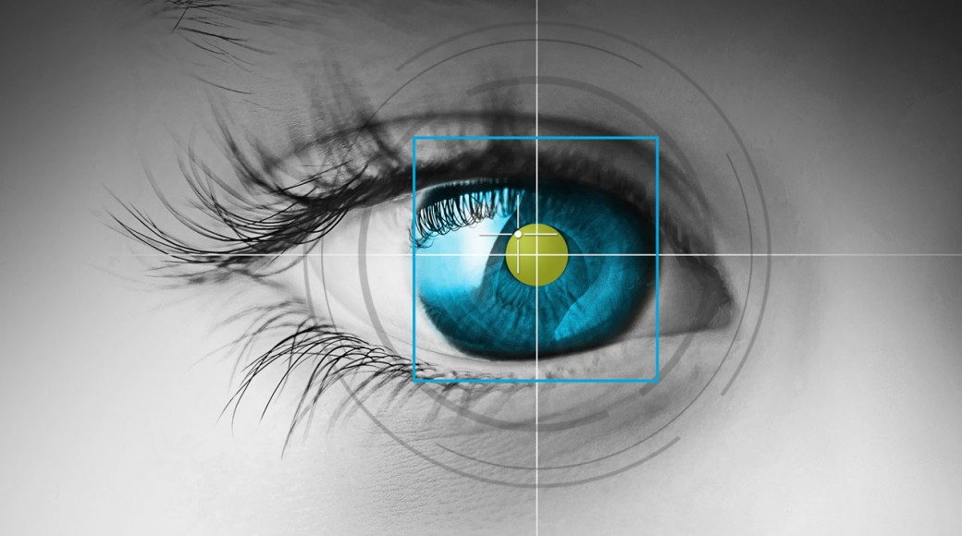
Who am I?
Instructor : Sampath Jayarathna Joined ODU Fall 2018 (Assistant Professor Cal Poly 2016-2018) Originally from Sri Lanka
Research : Eye tracking, Brain EEG, neuro-IR, Machine Learning
Web : http://www.cs.odu.edu/~sampath/
Contact : E&CS 3109, sampath@cs.odu.edu, (757) 683-7787
Office Hours : T 3pm – 4pm, or email me for an appointment
[Open Door Policy]

Slide 4
Course Information
Schedule : Tuesday, Time: 4.20 PM – 7.00 PM http://www.cs.odu.edu/~sampath/courses/f19/cs620 https://piazza.com/odu/fall2019/cs620/home
https://www.blackboard.odu.edu/
Prereqs
There are no specific course prerequisites for this course. But, I expect you to be comfortable learning new programming languages/tools/APIs, and knowledge in linear algebra and statistics.
Format
Before lecture: do reading slides
In lecture: put reading in context
After lecture: assignments, projects for hands-on practice

Slide 5
Student Learning Outcomes
After successfully completing this course, students should be able to:
Define and explain the key concepts and models relevant to data science.
Understand the processes of data science: identifying the problem to be solved, data collection, preparation, modeling, evaluation and visualization.
Develop an appreciation of the many techniques for data modeling
Be comfortable using commercial and open source tool such as python and associated libraries for data analytics and visualization.

Slide 6

Communication
Piazza:
All questions will be fielded through Piazza.
Many questions everyone can see the answer
You can also post private messages that can only be seen by the instructor
Blackboard:
Blackboard will be used primarily for assignments/homework submission, and grade dissemination.
Email:
Again, email should only be used in rare instances, I will probably point you back to Piazza

Slide 7

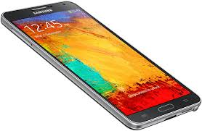
The Rules

Slide 8
Cooperate on Learning
Except for the work you hand in as individual contributions, I strongly encourage you to collaborate and help each other
If in doubt if a collaboration is legitimate: ask!
Don’t claim to have written code that you copied from others or online
Don’t give anyone else your code (to hand in for a grade)
When you rely on the work of others, explicitly list all of your sources – i.e. give credit to those who did the work
Don’t study alone when you don’t have to
Form study groups
Do help each other (without plagiarizing)

Slide 9
Course Organization – Tentative Schedule
Week 1 (Aug 27): Syllabus and Introductions, Python Workshop
Week 2 (Sep 3): Pandas
Week 3 (Sep 10): NumPy
Week 4 (Sep 17): Data Wrangling
Week 5 (Sep 24): Unstructured and Semi-Structured Data
Week 6 (Oct 1): NoSQL
Week 7 (Oct 8): Mid-Term Exam
Week 8 (Oct 15): No Class – Fall Break
Week 9 (Oct 22): Text Data Analysis and Inference
Week 10 (Oct 29): Machine Learning on Data
Week 11 (Nov 5): Machine Learning on Data
Week 12 (Nov 12): Evaluations
Week 13 (Nov 19): Delivering Results
Week 14 (Nov 26): Recommender Systems + Final Revision
Week 15 (Dec 3): Final Exam

Slide 10
Course Organization
Grading
Required Materials
No textbook is required. All the key course content will be documented in slides, which will be available in the course website after each lecture.
Bring Your Own Device (BYOD).

Slide 11
New Attendance Management Tools
Each time you attend class in one of the classrooms with attendance management (see list below) you should check in using a mobile app on your phone or by swiping your student ID card. It's easy:
Swipe your ID card.
Pull out your student ID card and swipe in at the device on the wall.
Watch the screen to validate that your swipe was successful.
Tap your ID card.
Pull out your student ID card and tap the check-in device on the wall.
Watch the screen to validate that your tap was successful.
Use the ODU Attendance app.
Download ODU Attendance from your Apple or Android app store.
Scan a QR code each time you arrive to class. Codes are unique to each class session, and will be refreshed and displayed in the room from 7:45 a.m. to 10 p.m. daily.
https://www.odu.edu/content/dam/odu/offices/occs/docs/attendance-management-students.pdf

Slide 12
Course Organization
Data Project: More in the next couple of slides…
Final Exam: The final exam is comprehensive, closed books and will be held on Tuesday, December 03 from 5.00 pm to 7.00 PM. You may bring one standard 8.5" by 11" piece of paper with any notes you deem appropriate or significant (front and back).
Midterm Exam: The midterm exam will be held on Tuesday during class time. For both exams, no iPads, iPhones, Blackberries, Android phones/tablets are allowed. Standard calculators are allowed.
Homework: We will have 5 homework assignments, each worth 5% of your overall grade..
In-class Activities and Attendance
ungraded in-class activities

Slide 13
Data Project
The data project is an opportunity to tackle a more challenging data science activity.
For the project, you are required to individually work on a dataset of your choosing that is interesting, significant, and relevant to Data Science.
The ultimate goal of your data project is to apply the techniques learn in each week of the class towards your dataset (exploration, wrangling, machine learning, visualization).
We are going to use Google Colab (Colaboratory) (https://colab.research.google.com/), a free Jupyter notebook environment that requires no setup and runs entirely in the cloud.

Slide 14
Team Project - Milestones
In Google Colab
Project Abstract, Sep. 17
Milestone checks, Oct. 1 & Nov. 05
Final Report Dec 06

Slide 15
Personal devices – Software Setup
Windows/Mac/Linux
Anaconda (or any other IDE)
Python 3.6 version
https://www.anaconda.com/download/
Weka 3.8
https://www.cs.waikato.ac.nz/ml/weka/downloading.html
jEdit
http://www.jedit.org/index.php?page=download
mongoDB community server
https://www.mongodb.com/download-center?jmp=nav#community

Slide 16
To-do and Next time
Sign up for the Piazza
Choose a dataset for your Data Project
HW1 is out!
Due, Sep 10

